Slide 1
SE-2001
Software Requirement Engineering
II. Requirements Engineering Processes
Dr. Abdul Aziz
Department of Software Engineering
School of Computing

Slide 2
Human and social factors
Requirements engineering processes are dominated by human, social and organizational factors because they always involve a range of stakeholders from different backgrounds and with different individual and organizational goals.
System stakeholders may come from a range of technical and non-technical background and from different disciplines
RE-2 <number>

Slide 3
Factors influencing requirements
Personality and status of stakeholders
The personal goals of individuals within an organization
The degree of political influence of stakeholders within an organization
RE-2 <number>

Slide 4
Process support
CASE (Computer-Aided Software Engineering) tools provide automated support for software engineering processes
The most mature CASE tools support well-understood activities such as programming, testing and project management
Support for requirements engineering is still limited because of the informality and the variability of the process
RE-2 <number>

Slide 5
Two types of CASE tools for RE
Modeling and validation tools support the development of system models which can be used to specify the system and the checking of these models for completeness and consistency.
Management tools help manage a database of requirements and support the management of changes to these requirements.
RE-2 <number>

Slide 6
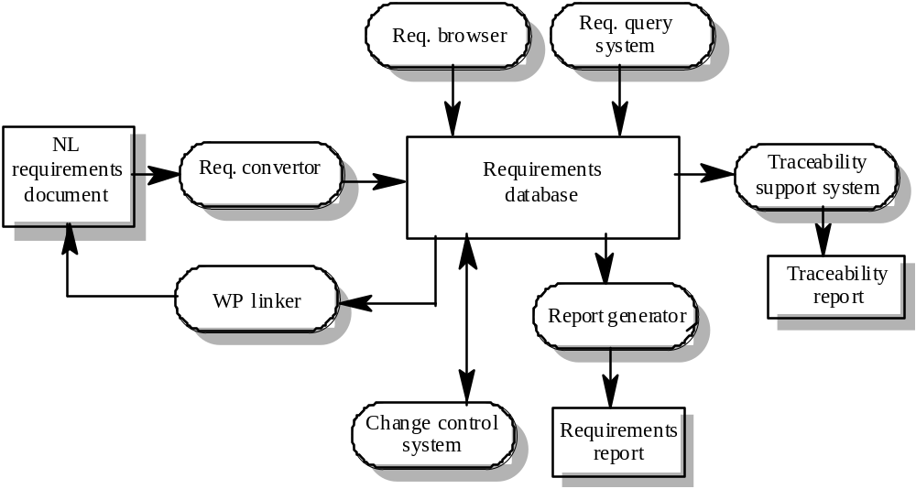
A requirements management system
RE-2 <number>

Slide 7
Requirements management tools
Requirements browser
Requirements query system
Traceability support system
Report generator
Requirements converter and word processor linker
Change control system
RE-2 <number>

Slide 8
Process improvement
Process improvement is concerned with modifying processes in order to meet some improvement objectives
Improvement objectives
  Quality improvement
  Schedule reduction
  Resource reduction
RE-2 <number>

Slide 9
Planning process improvement
What are the problems with current processes?
What are the improvement goals?
How can process improvement be introduced to achieve these goals?
How should process improvements be controlled and managed?
RE-2 <number>

Slide 10
RE process problems
Lack of stakeholder involvement
Business needs not considered
Lack of requirements management
Lack of defined responsibilities
Stakeholder communication problems
Over-long schedules and poor quality requirements documents
RE-2 <number>

Slide 11
Process maturity
Process maturity can be thought of as the extent that an organization has defined its processes, actively controls these processes and provides systematic human and computer-based support for them.
The SEI’s Capability Maturity Model is a framework for assessing software process maturity in development organizations
RE-2 <number>

Slide 12
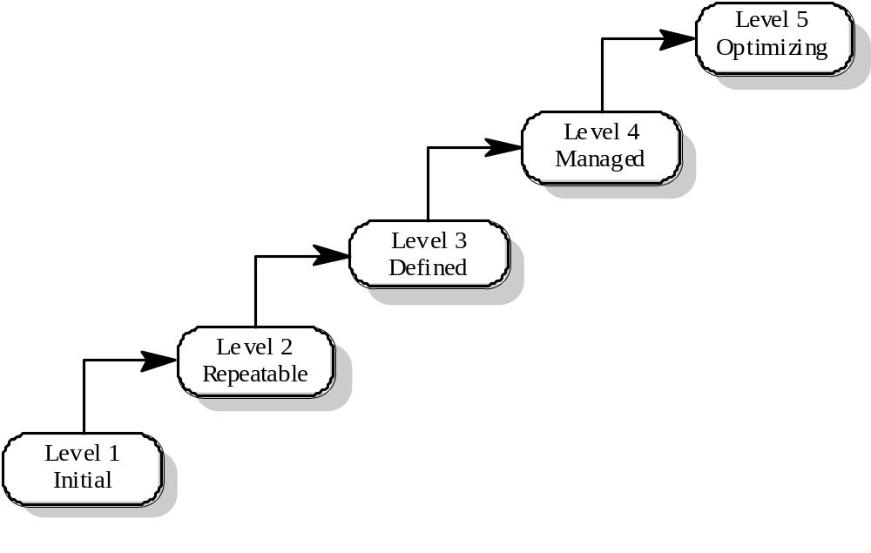
Capability maturity model
RE-2 <number>

Slide 13
Maturity levels
Initial level
  Organizations have an undisciplined process and it is left to individuals how to manage the process and which development techniques to use.
Repeatable level
  Organizations have basic cost and schedule management procedures in place. They are likely to be able to make consistent budget and schedule predictions for projects in the same application area.
Defined level
  The software process for both management and engineering activities is documented, standardized and integrated into a standard software process for the organization.
RE-2 <number>

Slide 14
Maturity levels
Managed level
  Detailed measurements of both process and product quality are collected and used to control the process.
Optimizing level
  The organization has a continuous process improvement strategy, based on objective measurements, in place.
RE-2 <number>

Slide 15
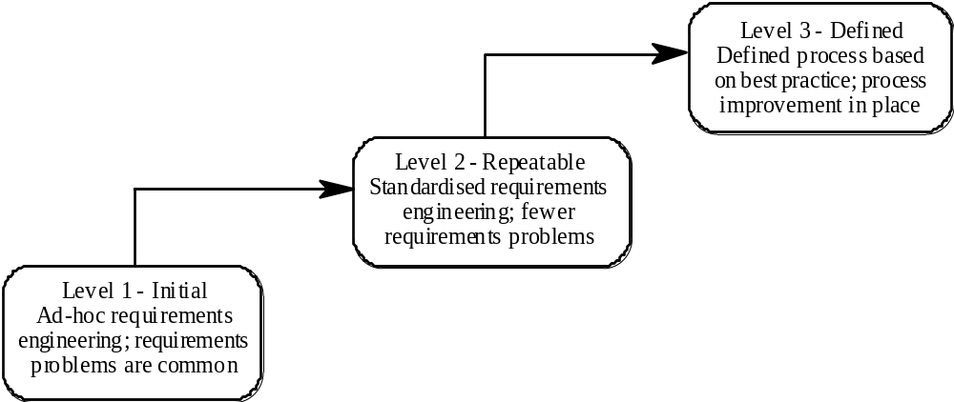
RE process maturity model
RE-2 <number>

Slide 16
RE process maturity levels
Initial level
  No defined RE process. Suffer from requirements problems such as requirements volatility, unsatisfied stakeholders and high rework costs. Dependent on individual skills and experience.
Repeatable level
  Defined standards for requirements documents and policies and procedures for requirements management.
Defined level
  Defined RE process based on good practices and techniques. Active process improvement process in place.
RE-2 <number>

Slide 17
Good practice for RE process improvement
RE processes can be improved by the systematic introduction of good requirements engineering practice
Each improvement cycle identifies good practice guidelines and works to introduce them in an organization
RE-2 <number>

Slide 18
Examples of good practice guidelines
Define a standard document structure
Uniquely identify each requirement
Define policies for requirements management
Use checklists for requirements analysis
Use scenarios to elicit requirements
Specify requirements quantitatively
Use prototyping to animate requirements
Reuse requirements
RE-2 <number>

Slide 19
Some Fundamental Truths
Truth 1: Requirements are not really about requirements.
  The requirements activity is not principally about writing a requirements document.
  Instead, it focuses on understanding a business problem and providing a solution for it.
RE-2 <number>

Slide 20
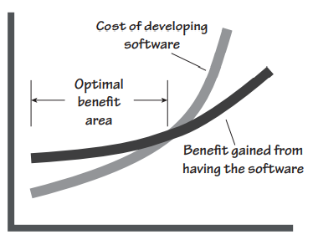
Truth 2: If we must build software, then it must be optimally valuable for its owner.
  The owner will not pay unless the product provides a benefit.
  Some Capability that was not previously available,
  Or changing some business process to be faster or cheaper or more convenient.
RE-2 <number>

Slide 21
Truth 3: If your software does not have to satisfy a need, then you can build anything. However, if it is meant to satisfy a need, then you have to know what that need is to build the right software.
RE-2 <number>

Slide 22
Truth 4: There is an important difference between building a piece of software and solving a business problem. The former does not necessarily accomplish the latter.
RE-2 <number>

Slide 23

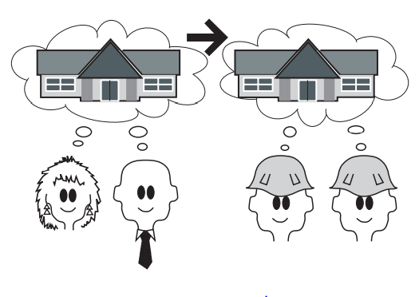
Truth 5: The requirements do not have to be written, but they have to become known to the builders.
RE-2 <number>

Slide 24
Truth 6: Your customer won’t always give you the right answer. Sometimes it is impossible for the customer to know what is right, and sometimes he just doesn’t know what he needs.
We also have the problem of incremental improvements.
It is far too common that when asked about a new system, stakeholders describe their existing system, and add on a few improvements.
It often results in mediocre products that fail to live up to expectations.
The business analyst has to perform a juggling act.
RE-2 <number>

Slide 25
Truth 7: Requirements do not come about by chance. There needs to be some kind of orderly process for developing them.
Truth 8: You can be as iterative as you want, but you still need to understand what the business needs.
Truth 9: There is no silver bullet. All our methods and tools will not compensate for poor thought and poor workmanship.
RE-2 <number>

Slide 26
Truth 10: Requirements, if they are to be implemented successfully, must be measurable and testable.
Truth 11: You, the business analyst, will change the way the user thinks about his problem, either now or later
RE-2 <number>

Slide 27
Assignment 1:
Question 1:
1.1. Explain the problems which might arise if the following requirements were included in a requirements document for a library system:
  The system shall provide an easy-to-use graphical interface based on MS Win 10.
  Accredited users should have privileged access to the cataloguing facilities of the system.
  The system software shall be implemented using separated modules for cataloguing, user access and archiving.
List possible stakeholders for a library cataloguing systems.
Suggest how the following requirements might be rewritten in a quantitative way.
  The library system shall be easy-to-use.
  The library system shall provide reliable service to all classes of users.
  The library system shall provide a rapid response to all user requests for book information.
RE-2 <number>

Slide 28
Question 2
Explain why there is a great deal of variability in the requirements engineering processes used in different organizations?
Explain why both coarse-grain and fine-grain activity models of a process should be produced in an organization.
Explain why waterfall model of the software process is not an accurate reflection of the detailed software process in most organizations. Why is spiral model more realistic?
Why is it important to understand the roles of people involved in requirements engineering processes?
What factors are likely to be particularly significant when considering requirements engineering process improvement?

